Slide 1
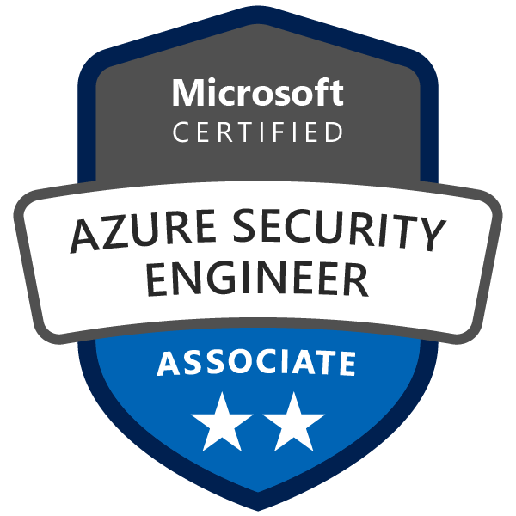
Exam AZ-500: Microsoft Azure Security Technologies Crash Course
Tim Warner

Slide 2


Tim Warner
Based in Nashville, TN, US
Central time zone
MCT, MVP
Twitter: @TechTrainerTim
Badge: TechTrainerTim.com

Slide 3
Course Materials
timw.info/az500

Slide 4
Session 1 of 2 Learning Goals
Introduction
Manage identity and access
Implement platform protection

Slide 5
Session 2 of 2 Learning Goals
Manage security operations
Secure data and applications
Lots of AZ-500 tips and tricks!

Slide 6
A Different Kind of Training
Let's avoid slide show fatigue
We'll learn by doing – at least 80 percent demo
Case study/scenario approach
10-minute break at midpoint
I’m here to answer your questions – take advantage of this!
Use the Q&A panel

Slide 7

Session Recordings

Slide 8
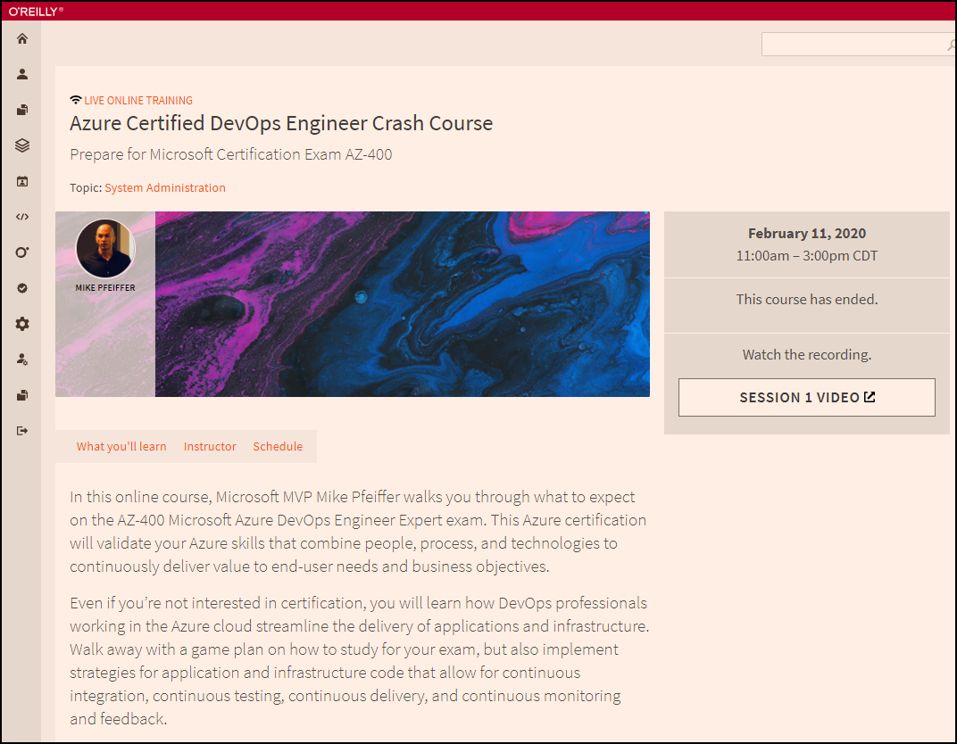
Session Recordings

Slide 9

Session Recordings

Slide 10


Session Recordings

Slide 11
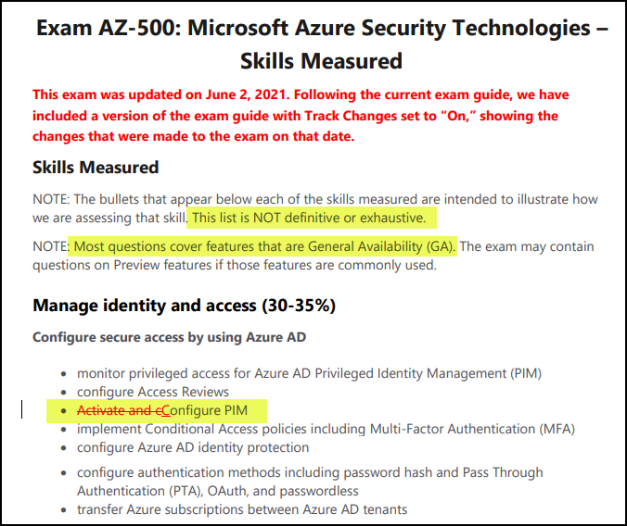
AZ-500 Changes: June 2, 2021

Slide 12

Tim's Certification Study Model
Content knowledge
Test-taking skills
Practical application

Slide 13
Thank you!
Course materials: timw.info/az500
Twitter: @TechTrainerTim
Work: timw.info/ps
Web: TechTrainerTim.com

Slide 14
Manage Identity and Access

Slide 15

Tenant vs. Subscription

Slide 16

Hybrid Identity

Slide 17

Passthrough Authentication

Slide 18

Seamless Single Sign-On

Slide 19
Seamless Single Sign-on

Slide 20

Azure Management Scopes
/ Tenant Root

Slide 21


Azure AD and Subscriptions

Slide 22
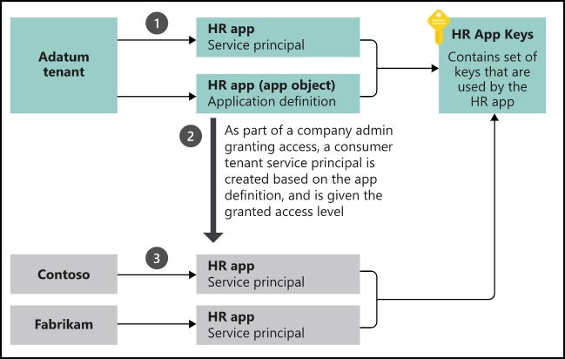
App registrations and service principals

Slide 23

Azure AD B2C

Slide 24

Azure AD Domain Services

Slide 25
Azure AD SSO

Slide 26
Passthrough Authentication

Slide 27

AD FS Federation

Slide 28
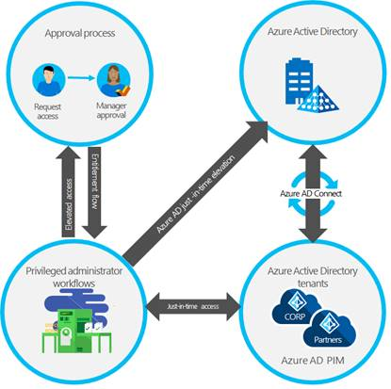
Azure AD PIM

Slide 29
Implement Platform Protection

Slide 30
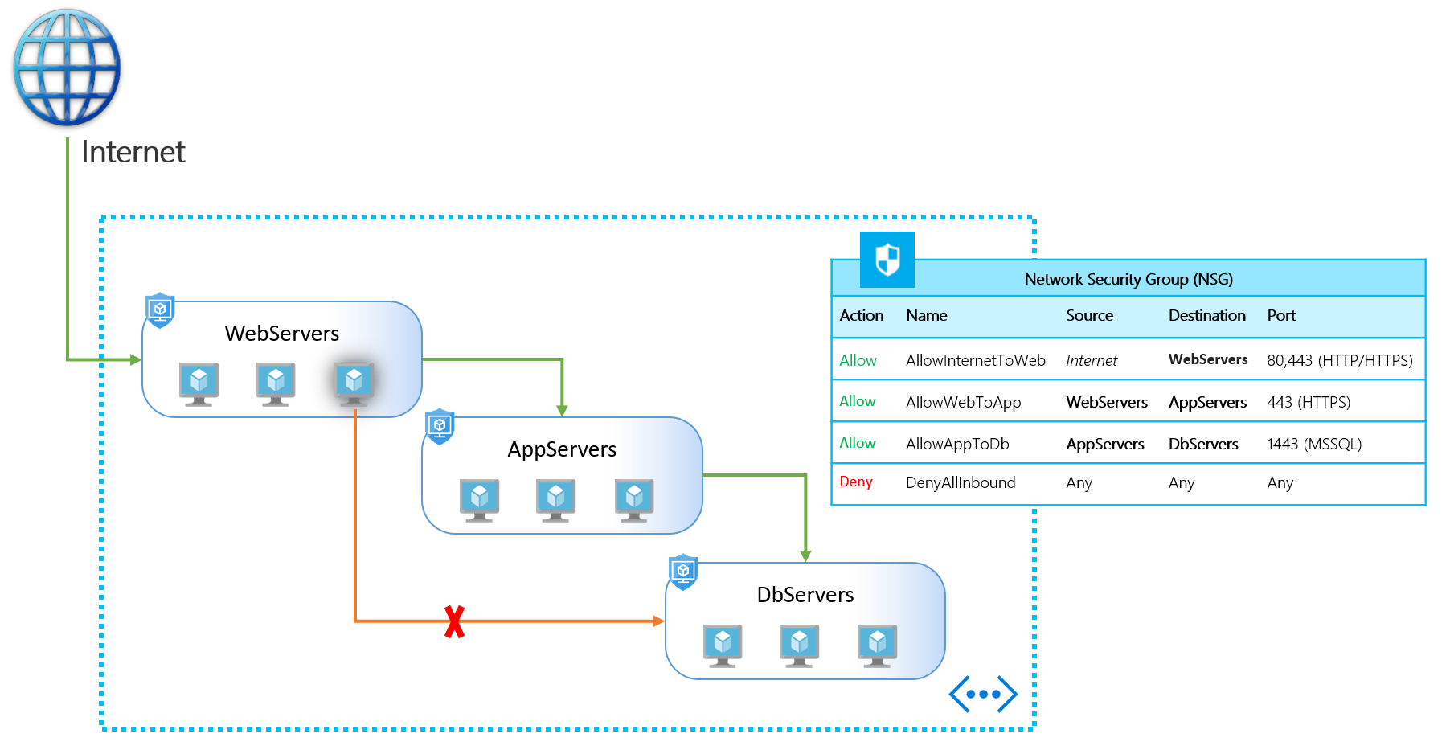
NSGs and ASGs

Slide 31

VM High Availability

Slide 32

Web App High Availability

Slide 33
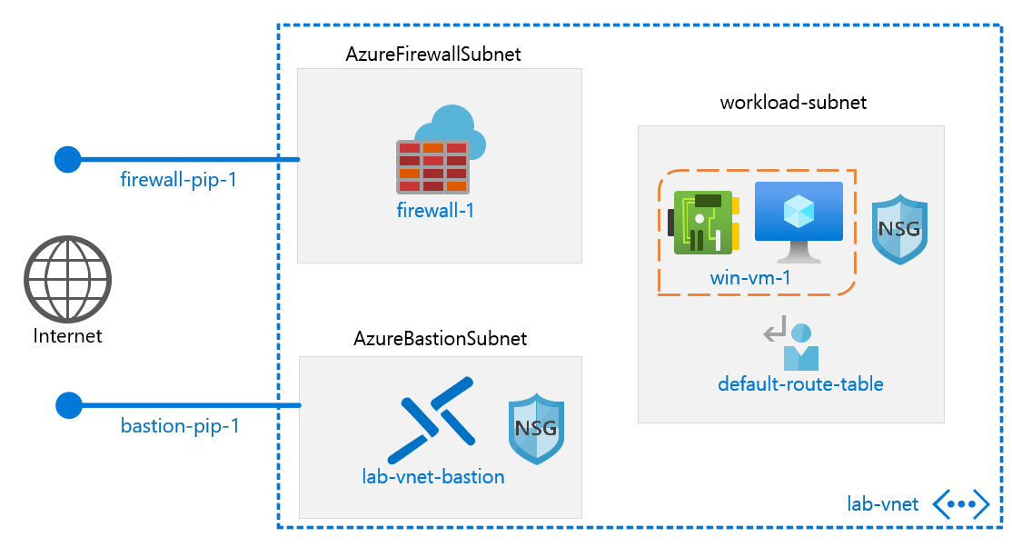
Azure Firewall

Slide 34
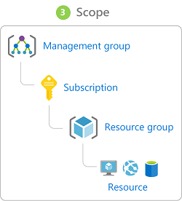
Azure Management Scopes
/ Tenant Root

Slide 35

Service endpoints

Slide 36
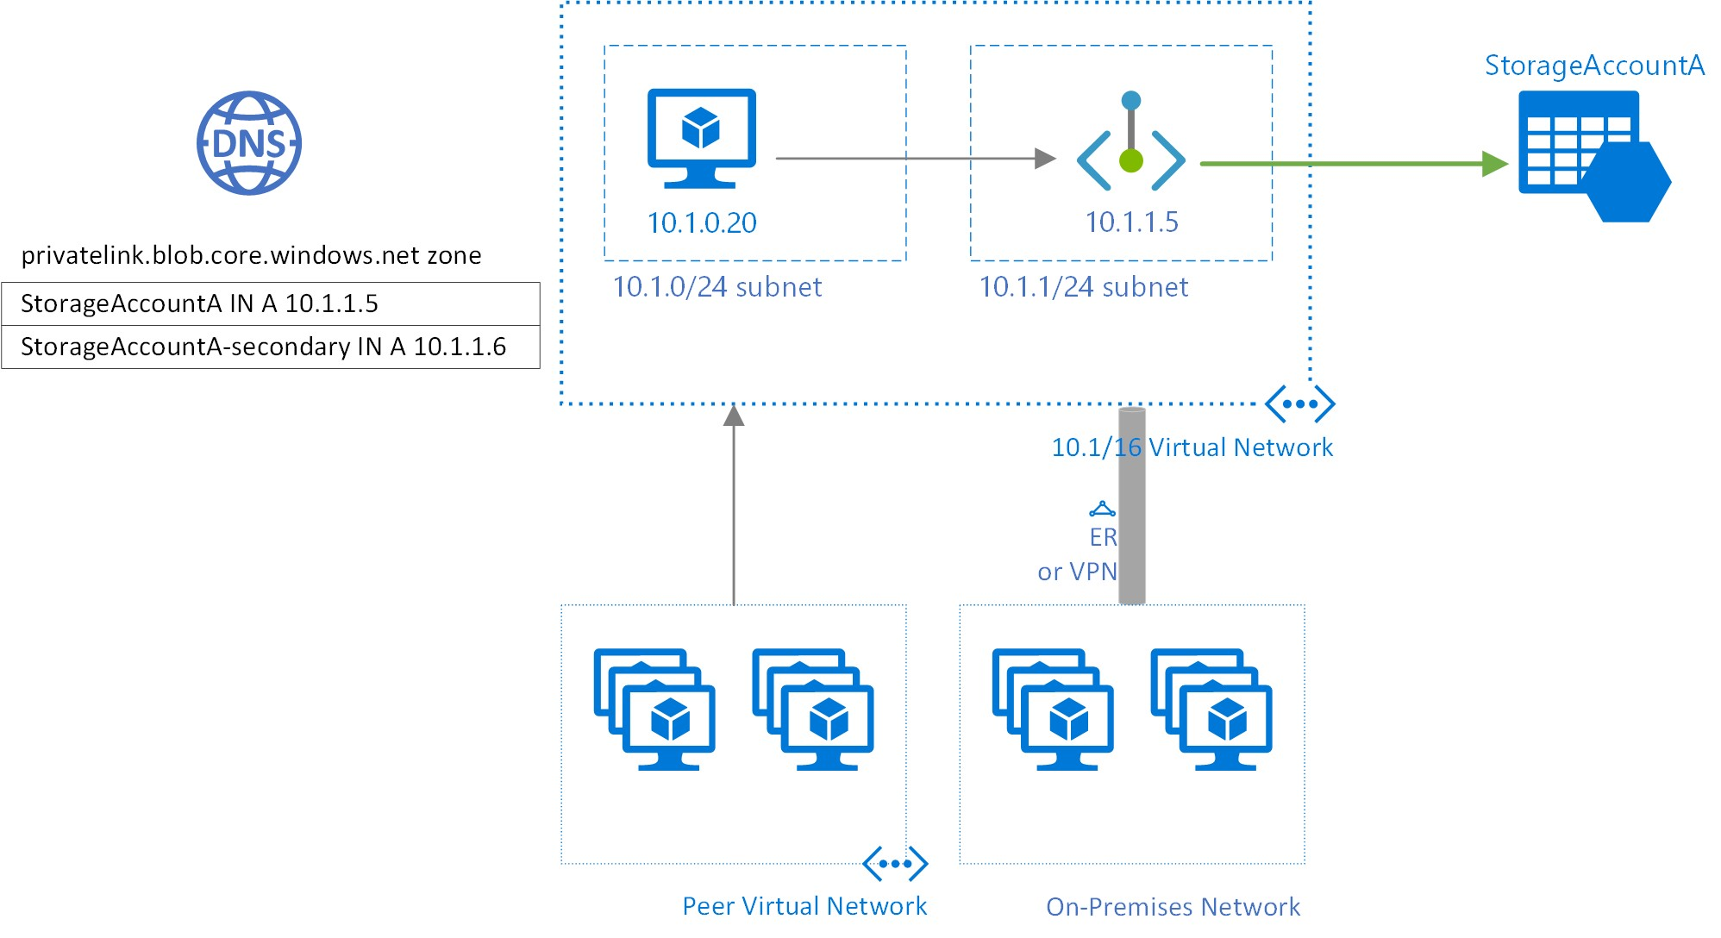
Private endpoints

Slide 37
Manage Security Operations

Slide 38
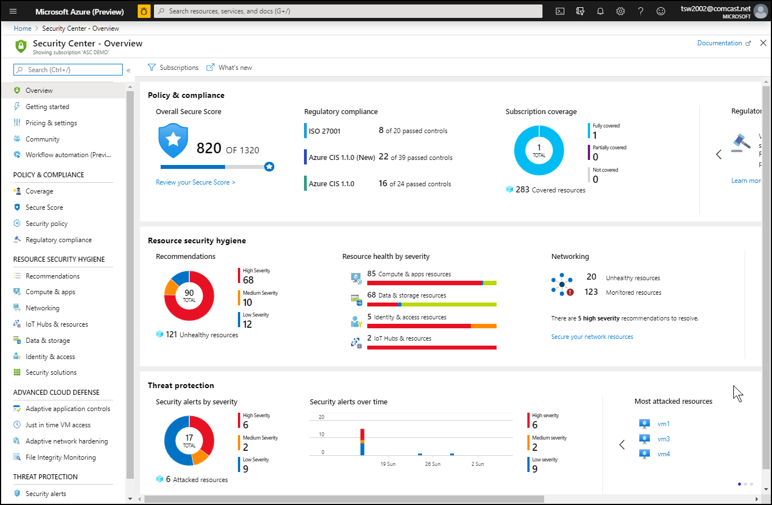
Azure Security Center

Slide 39
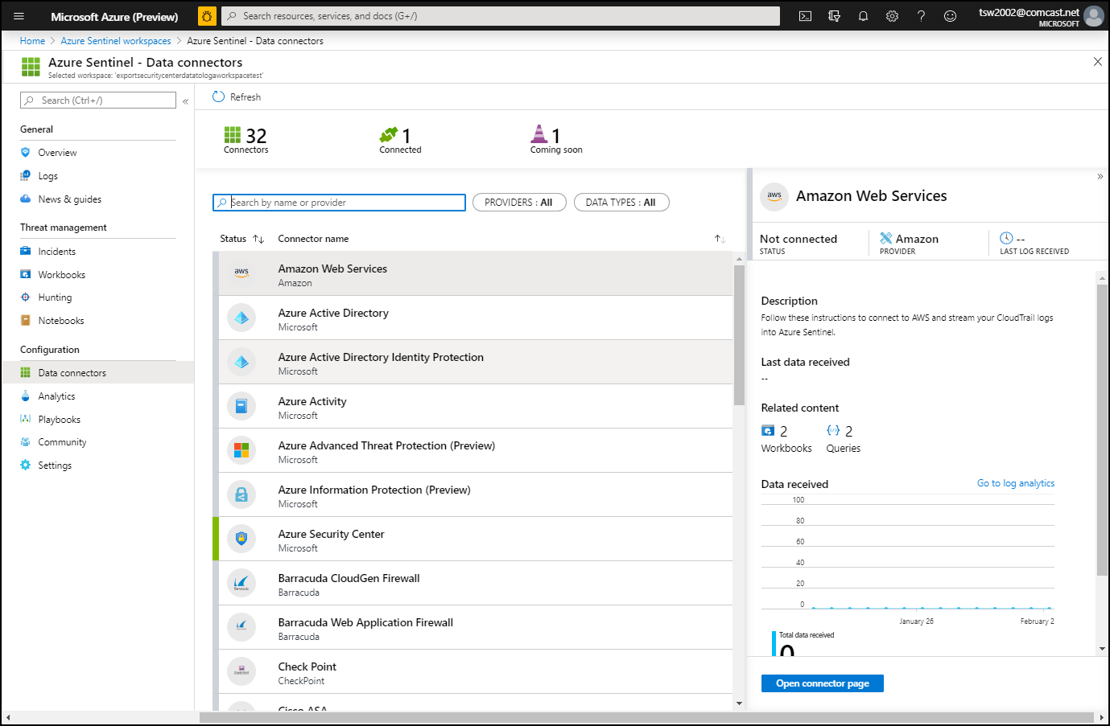
Azure Sentinel

Slide 40
Secure Data and Applications

Slide 41
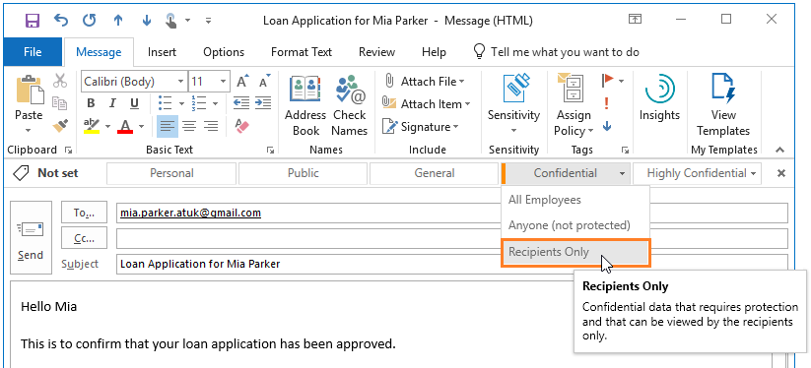
Azure Information Protection

Slide 42
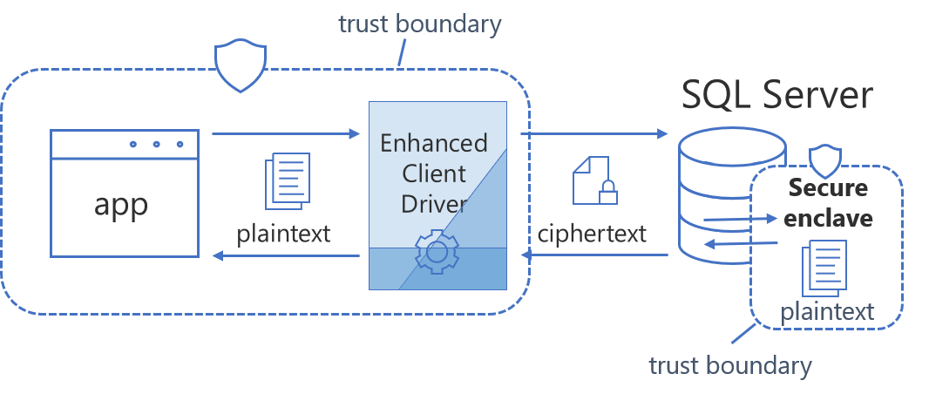
Always Encrypted

Slide 43
Exam AZ-500 Item Types

Slide 44

Single Answer Multiple Choice

Slide 45

Multiple Answer Multiple Choice

Slide 46
Repeated Scenario
You need to move an Azure VM to another hardware host.
Solution: You redeploy the VM.
Does this solution meet the goal?
Yes
No

Slide 47
Repeated Scenario
You need to move an Azure VM to another hardware host.
Solution: You enable boot diagnostics.
Does this solution meet the goal?
Yes
No

Slide 48

Select and Place

Slide 49

Build List and Reorder

Slide 50

Active Screen/Fill in the Blank

Slide 51

Case Study

Slide 52






Performance-Based Lab

Slide 53
Microsoft Online Testing

Slide 54
Microsoft Online Testing Process
timw.info/online

Slide 55

Microsoft Online Testing Process

Slide 56

Microsoft Online Testing Process

Slide 57

Microsoft Online Testing Process

Slide 58

Microsoft Online Testing Process

Slide 59

Microsoft Online Testing Process

Slide 60

Microsoft Online Testing Process

Slide 61

Microsoft Online Testing Process

Slide 62
AZ-500 Exam Strategy
Focus your skills accordingly:
60 percent Azure portal
20 percent Azure PowerShell
10 percent Azure CLI
10 percent KQL
Azure AD PIM all day long
Expect performance-based labs, but be happy if you don't see 'em

Slide 63
Parting Advice
Check out my YouTube (timw.info)
Online testing
Cert item strategy
AZ-500 study guide
Invest in Whizlabs or MeasureUp
Register for your exam ASAP!

